Slide 1
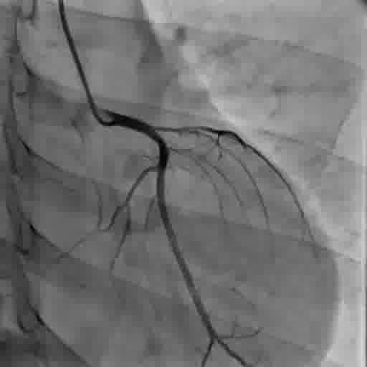
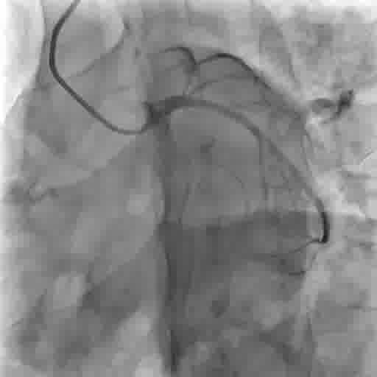
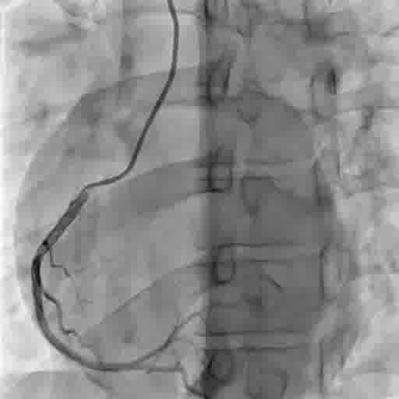
CAG
CAG :
LM Distal –Minor plaque plaque extending to LAD and 95% stenosis in osteo-proximal LASD
LCX –Normal
RCA – Normal caliber , dominant and Disease free.
Syntax score I2

Slide 2
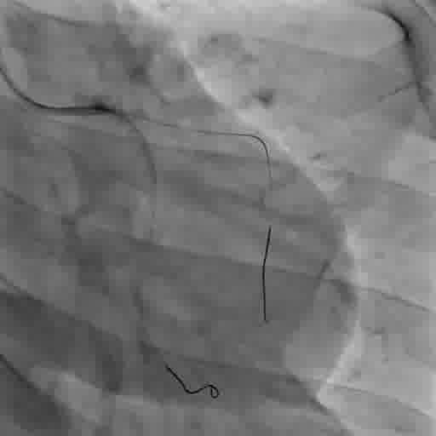
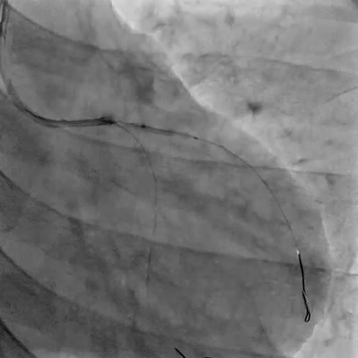
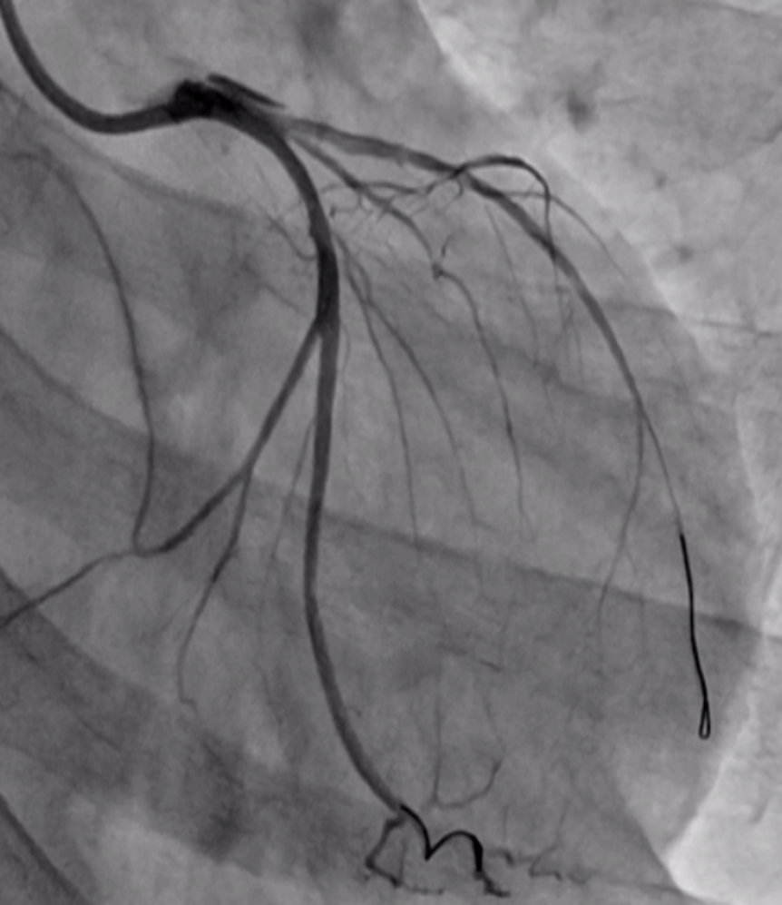
PCI
Wired both LAD& LCX
Predilatation done with 2.0x12 mm semi complaint balloon
Dissection

Slide 3
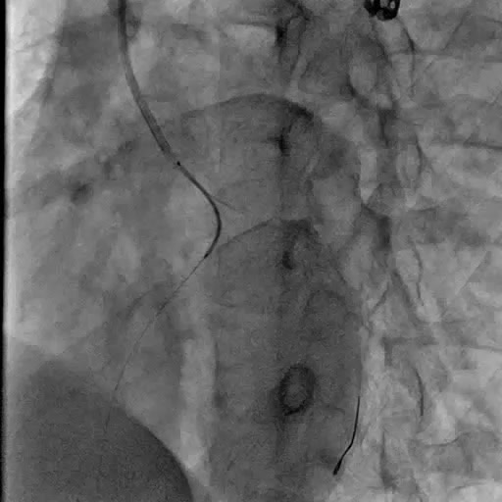
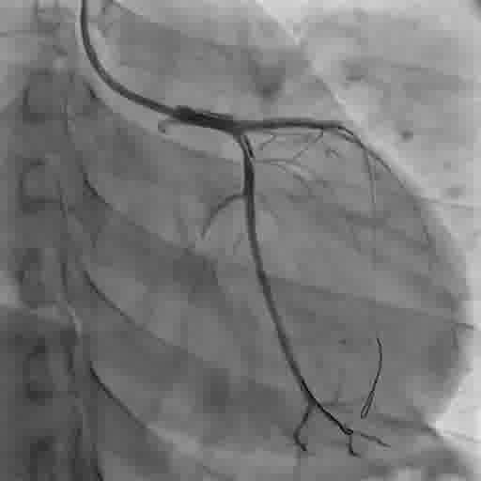
3.5x 28 mm stent deployed from LM ostia to proximal LAD
Unfortunately there were dissection in LCX

Slide 4
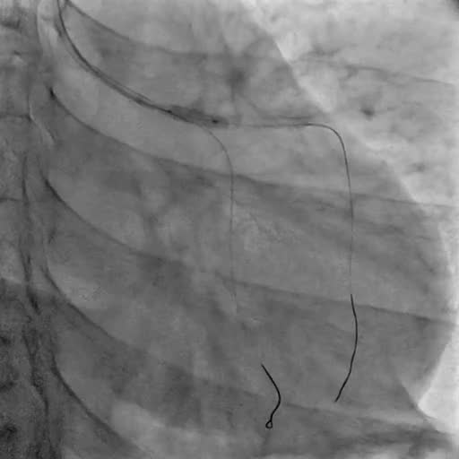
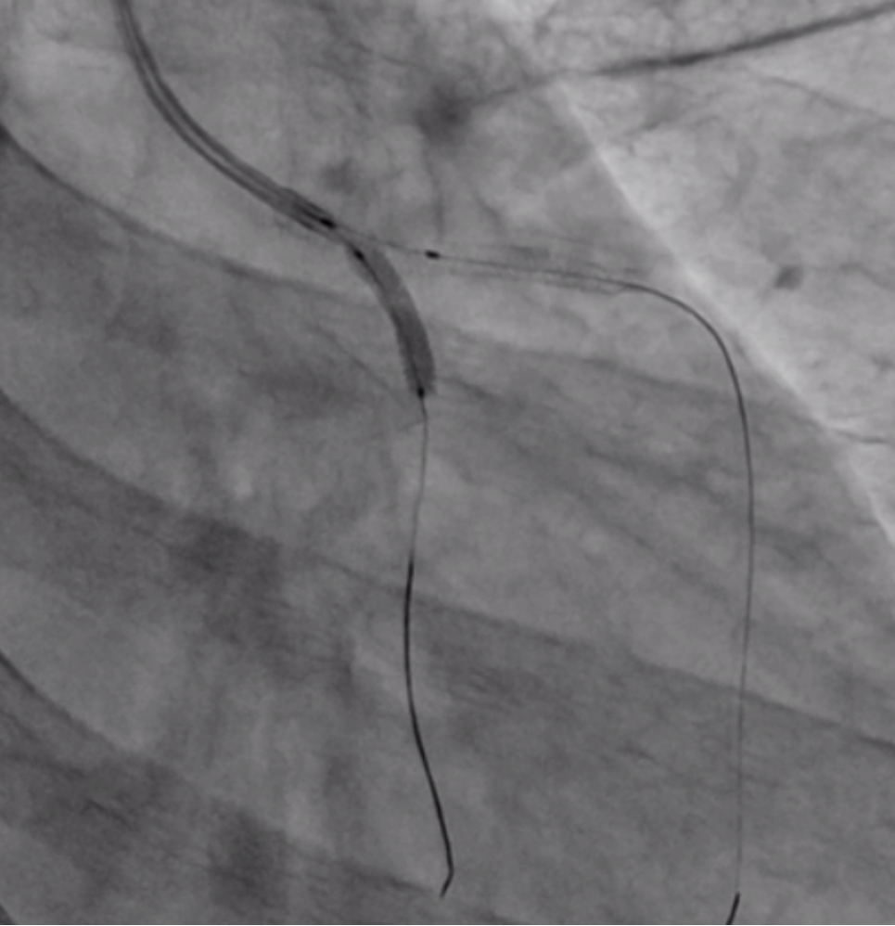
PCI to LCX
3.5x28mm
POT done with 4.5x8mm NC balloon

Slide 5
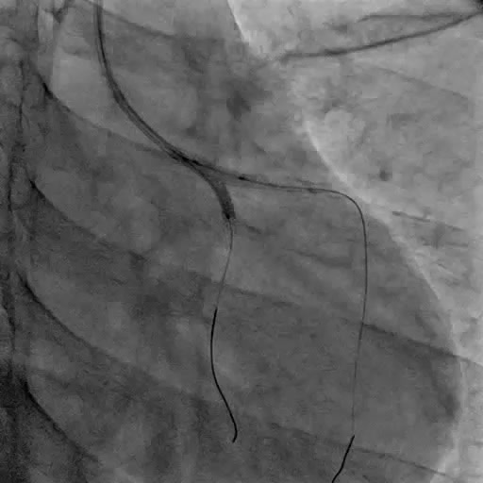
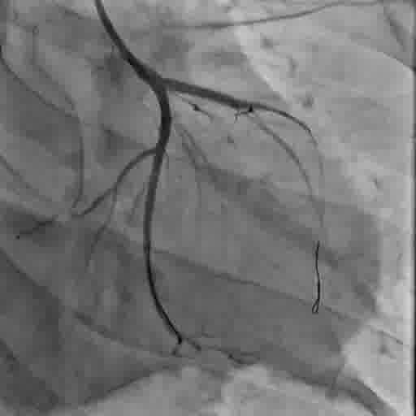
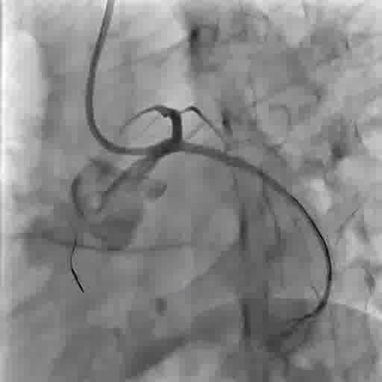
FKBI to LAD & LCX
Final cine

Slide 6
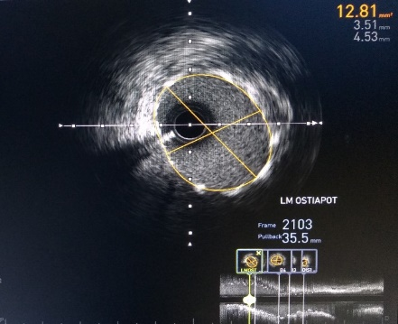
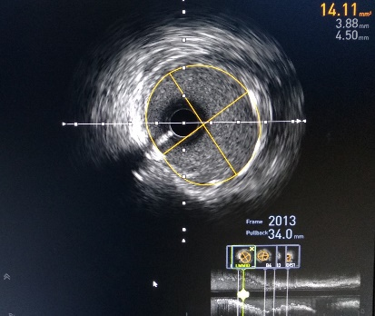
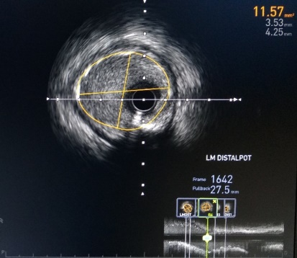
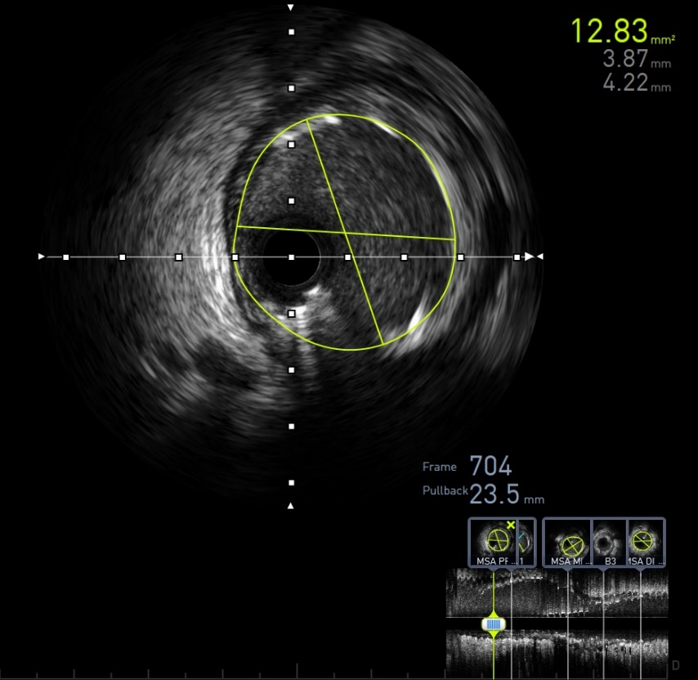
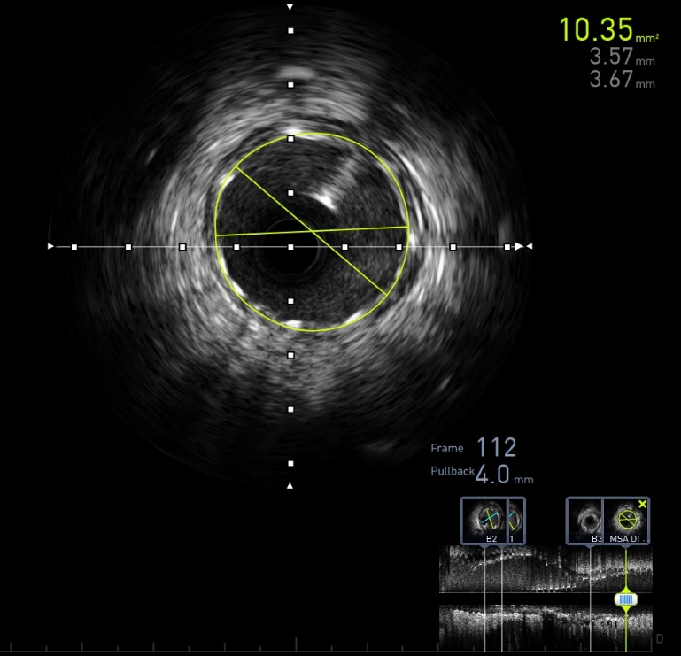
AFTER PCI
Osteal LM
Lm mid
LAD ostium
Prox LCX
Mid LCX

